Slide 1
GI Case of the month
July 2026
Dr. Maryam Ashfaq, M.D., PGY-1
Dr. Roshan Raza M.D.

Slide 2
Clinical History
57-year-old man with a history of ulcerative proctitis and intermittent rectal bleeding underwent screening colonoscopy
Colonoscopy: Unremarkable without evidence of active inflammation or mucosal abnormalities.
Biopsies were taken from terminal Ileum, ascending, transverse, descending colon and rectum

Slide 3
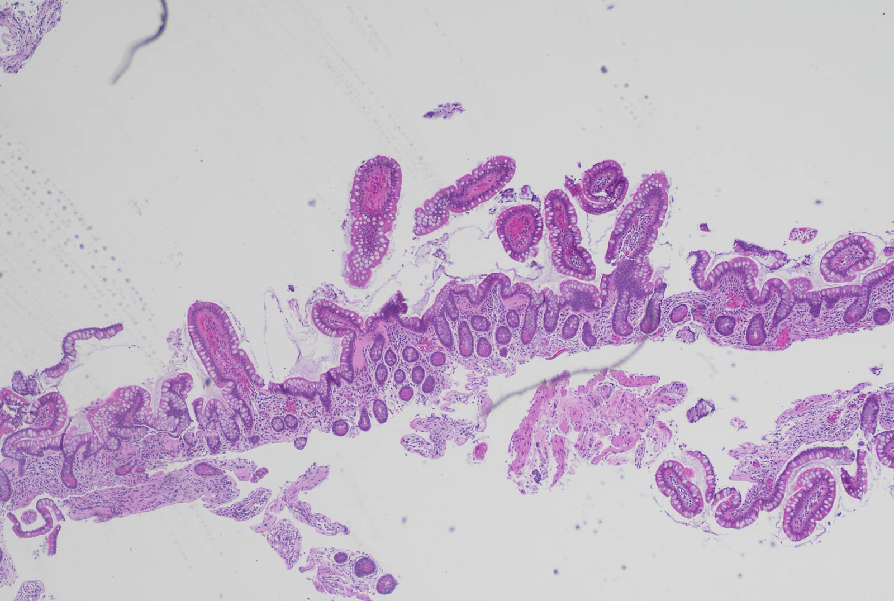
H&E 2X: preserved villous architecture with subepithelial collagen band thickening (blue arrow)

Slide 4
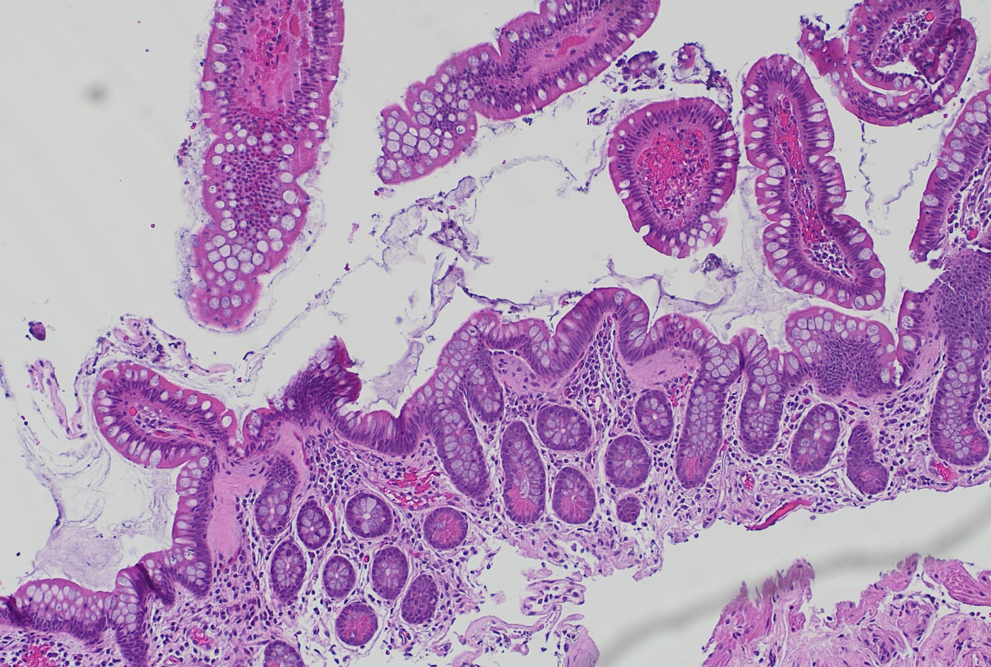
H&E 10X: preserved villous architecture with subepithelial collagen band thickening (arrows)

Slide 5
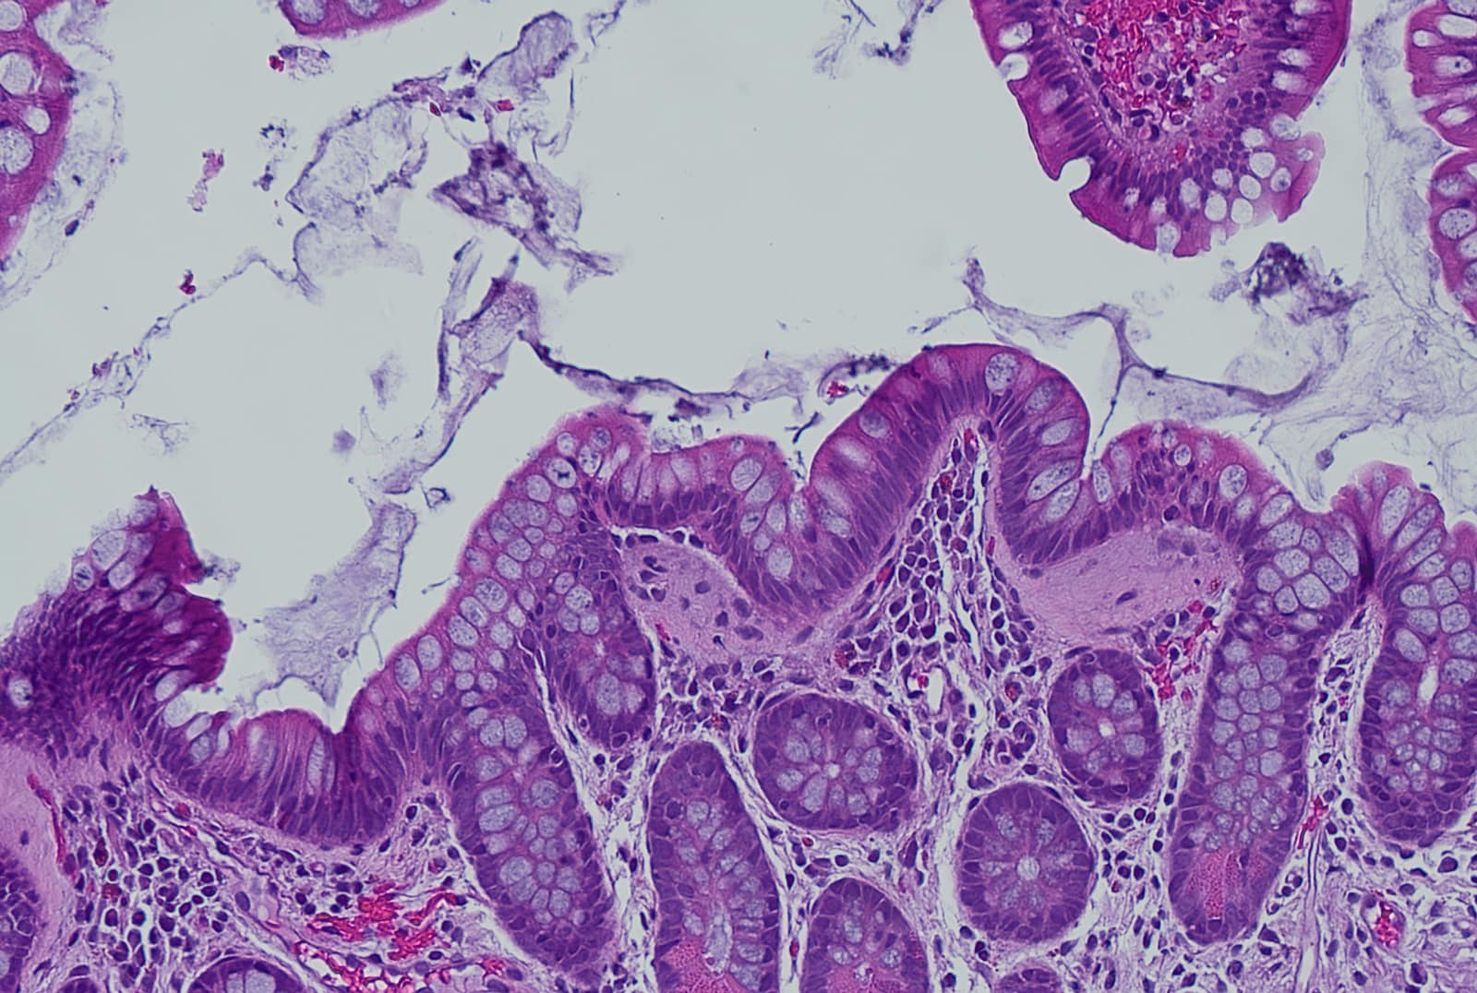
H&E 20X: preserved villous architecture with subepithelial collagen band thickening (arrow)

Slide 6
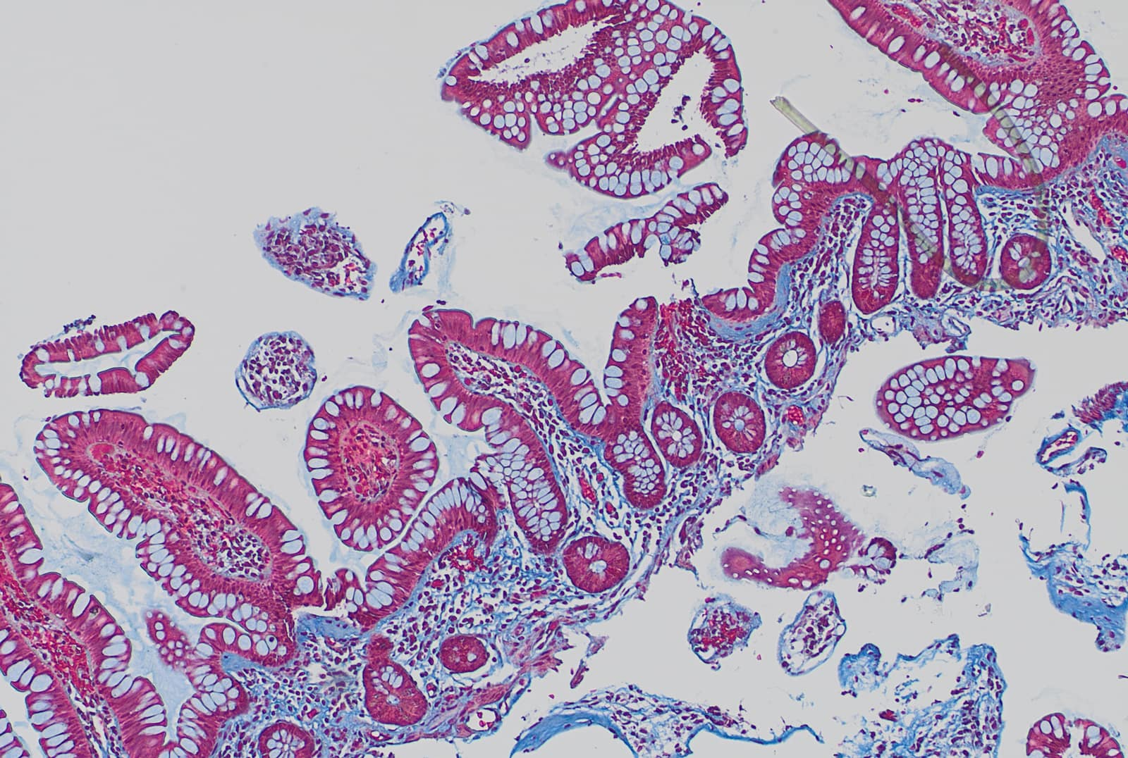
Trichrome staining (20X) highlights subepithelial collagen band thickening

Slide 7
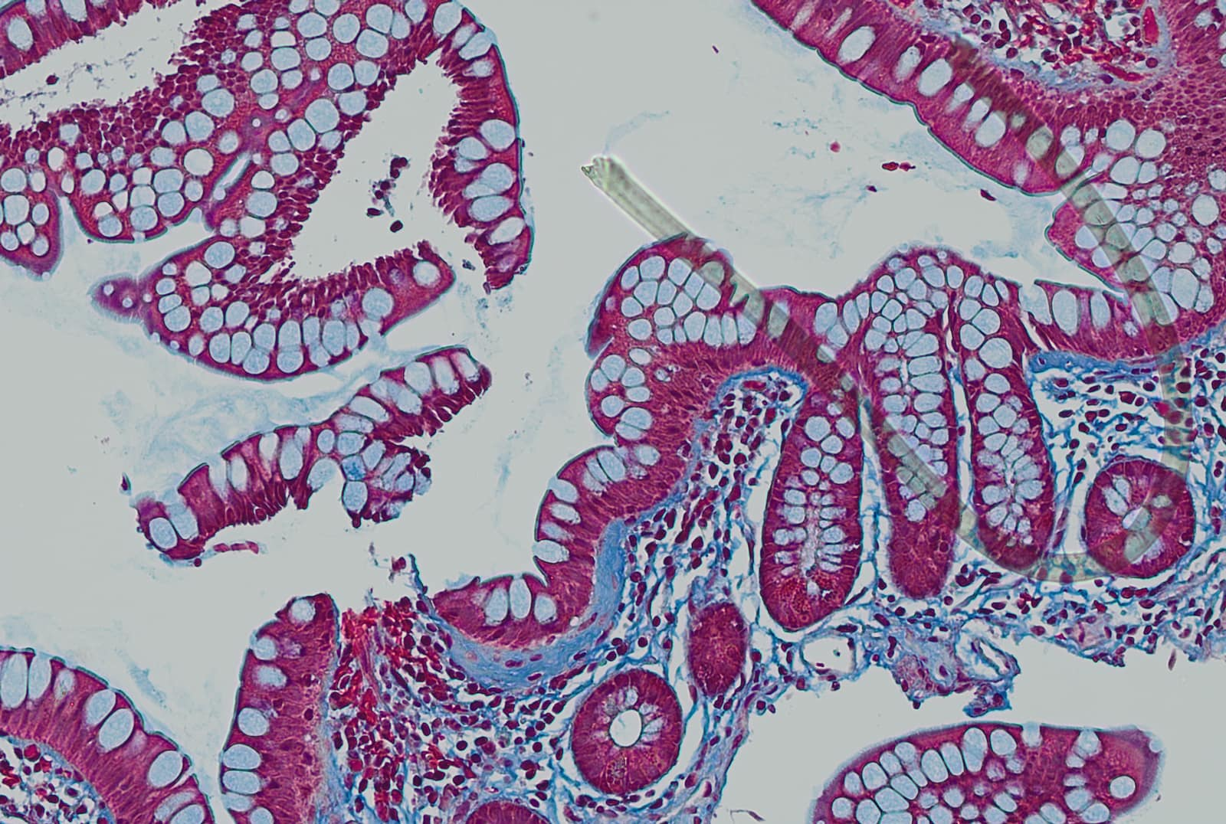
Trichrome staining (40X) highlights subepithelial collagen band thickening

Slide 8
Final Diagnosis
Terminal Ileum, biopsy:
- Small intestinal mucosa with patchy increase in subepithelial collagen, suggestive of collagenous ileitis (assessed on trichrome stain).
- Negative for active inflammation, dysplasia and granuloma.
- Negative for intraepithelial lymphocytosis and villous blunting (assessed on CD3 stain)

