Slide 1
EAC Quarterly Meeting
Texas EMSC State Partnership
May 9th, 2018 – 2:30pm
Wyndham Garden Hotel
Program Manager: Joseph Santos
Program Director: Saranya Srinivasan, MD
Notes:
Text
Text
Text
Text

Slide 2
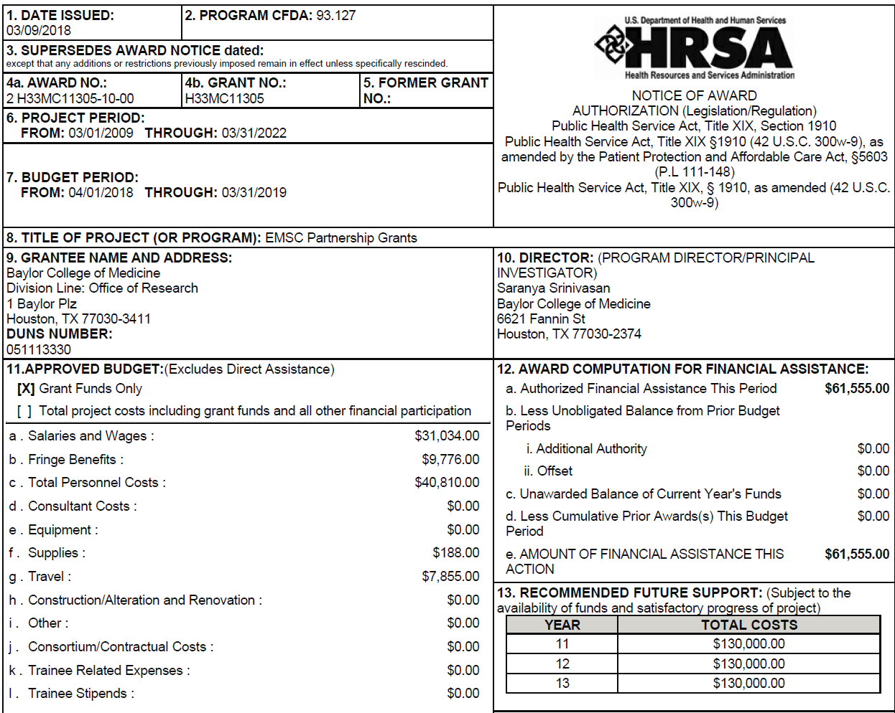
Grant Notice of Award

Slide 3
EMSC Overview
Our Goals
Ensure that state-of-the-art emergency medical care is available for the ill or injured child or adolescent is when needed
Ensure that pediatric services are well integrated into the existing state EMS system
Ensure that the entire spectrum of emergency services, including primary prevention of illness and injury, acute care, and rehabilitation, is provided to children and adolescents at the same level as adults.

Slide 4
Role of the EAC
Provide guidance to the State Partnership through vigilant exploration of the state of pediatric emergency medical care in Texas
Identification of EMSC priorities
Development of a strategic plan to address priorities and to establish permanence
Implementation and evaluation of the strategic plan

Slide 5
Ongoing EMSC Projects
Voluntary Pediatric Readiness Program (VPRP-FAC)
Voluntary Pediatric EMS Readiness Program (VPRP-EMS)
Hospital Survey (Re-Assessment) for Performance Measures 06 and 07
Proposed projects involving FAN Rep
Notes:
Explain that we will be providing updates on all of these projects during the presentation

Slide 6
Voluntary Pediatric Readiness Program (VPRP)
Started Pilot for Peds “READY” in Jan 2018
Start “Peds Ready” pilot Jan’18
12 facilities with 12 additional “alternates”
Conduct virtual surveys between May - Jul
Conclude Pilot end of July
Provide report to EAC on “Peds Ready” Pilot (Aug’18)

Slide 7
VPRP Timeline
2018
Pediatric “READY”
Cat I (< 1,800 / yr) = 3
Cat II (1,800 - 4,999/yr) = 3
Cat III (5K - 9,999 visits/yr) = 3
Cat IV (> 10K visits / year) = 3
2019
Pediatric “CHAMPION”
2020
Pediatric “INNOVATOR”

Slide 8
VPRP List of Facilities
Harris Health System Ben Taub General Hospital | William David | Spoke on Phone/Sent Info
Texas Health Arlington Memorial Hospital | Clint Laveve / Debbie | Called - Left Message
Northwest Texas Hospital | Jean Whitehead | Called - Left Message
Abilene Regional Medical Center | Vesha | Called - Left Message
McAllen Medical Center | Rebecca Callaway | Called - Left Message
Tomball Regional Medical Center | Vicky Wooddell | Spoke on Phone/Sent Info
Covenant Hospital Plainview |  | Confirmed
Grimes St. Joseph Health Center | Debbie Griffith | Spoke on Phone/Sent Info
Memorial Hospital | Jessica | Called - Left Message
Big Bend Regional Medical Center | Merisa Ramerez | Called - Left Message
Red River Regional Hospital | Lisa | Called - Left Message
St. Mark's Medical Center | Amanda | Called - Left Message

Slide 9
List of Additional Facilities
Longview Regional Medical Center
Nacogdoches Memorial Hospital
Providence Memorial Hospital
Sierra Medical Center
University Medical Center of El Paso

Slide 10
How to solicit more hospitals
Ideas and suggestions on how to recruit more hospitals to be part of the pilot project
Thoughts from the group?

Slide 11
Voluntary Pediatric EMS Readiness Program
Multi – phase recognition program for EMS agencies who wish to establish programs and standards to improve their ability to deliver care to pediatrics.
BRONZE
SILVER
GOLD

Slide 12
List of Recognized Agencies/Departments
Cedar Hill Fire Department - GOLD
Montgomery County Hosp District - GOLD
Booker EMS - GOLD
Williamson County EMS - GOLD
Friendswood Volunteer Fire Dept - GOLD
Clear Lake Emergency Corps - GOLD

Slide 13
Pending Agencies/Departments
Dalhart EMS
BSA Hospital LLC dba BSA Health Systems EMS
Texas EMS
Watuaga Fire Department
* Pilot the use of iPad to conduct “virtual” site surveys.

Slide 14
Voluntary Pediatric EMS Readiness Program Timeline
Open Program to State in May’18
Report on Program to EAC / GETAC in Aug’18

Slide 15
Hospital Survey (Re-Assessment) for Performance Measures 06 and 07.
NEDARC will be assisting all states in completing a national re-assessment examining the presence of interfacility transfer guidelines and agreements that cover pediatric patients within emergency departments throughout the state
Notes:
Explain that the agencies in white are pending site visits

Slide 16
Performance Measures
Performance Measure 06:
Addresses the percentage of hospitals with an Emergency Department (ED) in the state or territory that have written inter-facility transfer guidelines that cover pediatric patients and that include specific components
Performance Measure 07:
Addresses the percentage of hospitals with an ED in the state or territory that have written inter-facility transfer agreements that cover pediatric patients
Notes:
Explain that the agencies in white are pending site visits

Slide 17
Sample Survey Questions:
Does your hospital have a ED open 24/7?
Does your hospital have written inter-facility guidelines…for the transfer of patients of all ages including children?
If no, then does your hospital have inter-facility agreements?
If no agreements, then please share thoughts related to inter-facility transfer guidelines/agreements.

Slide 18
Sample Survey Questions (cont)
If you do have transfer guidelines:
Please define the process for initiation of transfers and roles and responsibilities of facility and referral center.
Process for selecting appropriate facility
Process for selecting staffed transport to match patient acuity
Process for informed consent, medical record transfer, transfer of signed consent, transfer of personal belongings, and directions for family members

Slide 19
Number of Hospitals to Survey
Total of 245 hospitals randomly selected from a list of 642.
141 had previously participated in the 2013 survey
104 are new to the survey
41 counties in the state
All RACs represented except for S and T

Slide 20
Survey Schedule
Survey launch (portal open) 5/14
Pre-notice email/mail 5/9
Survey invitation 5/14-15
First reminder 5/17
Second reminder 5/22
Third reminder 6/12
Fourth reminder 6/26
Final contact 7/10
Portal closes 8/17

Slide 21
Family Advisory Network Representative
Created in 1999 by the EMSC program to facilitate the inclusion of family representatives in state EMSC programs
Assures the needs of families are addressed when a child is in need of health care
Allows families to be part of the care team while supporting the child

Slide 22
Roles and Jobs of a FAN Rep
Brief overview of recent HRSA All Grantee Meeting in Austin from April 30th through the 2nd of May.
Focus on State Partnership Program Managers, PRQC Collaborative Training and FAN Representative(s)

Slide 23
Texas EMSC FAN Representatives
Sherry Santa, Texas Parent 2 Parent
Rosalba Calleros, Texas Parent 2 Parent

Slide 24
Pediatric Readiness Quality Collaborative (PRQC)
QI collaborative to assist state programs in accelerating their progress in improving the pediatric readiness of EDs through new interventions
A Train-the-Trainer model will be used to provide regional networks with tools to improve pediatric readiness
Twenty teams composed of training and affiliate sites will be guided to develop local quality improvement efforts to foster pediatric readiness

Slide 25
Targets of QI Initiative
A patient safety initiative focused on collecting and documenting pediatric patients’ weights in kilograms only
Developing a notification process for abnormal vital signs
Ensuring inter-facility transfer guidelines are patient and family centered
Establishing disaster plans that include children

Slide 26
Participants
Hospital Name | Role in PRQC
Dell Seton Medical Center at the UT - Seton Healthcare Family | Affiliate Site
Providence Health Center | Affiliate Site
Seton Edgar B Davis Hospital | Affiliate Site
Seton Highland Lakes | Affiliate Site
Seton Medical Center Austin - Seton Main | Affiliate Site
Seton Medical Center Hays | Affiliate Site
Seton Northwest - Seton Family of Hospitals | Affiliate Site
Seton Southwest - Seton Family of Hospitals | Affiliate Site
Seton Williamson | Affiliate Site
Dell Children's Medical Center of Central Texas | Training Site
Seton Smithville Hospital | Training Site
Joseph Santos | EMSC Manager

Slide 27
State Partnership PM Involvement
Facilitate communication between sites and EMSC program
Available to serve as a resource and/or consultant for pediatric readiness
Often may have information for participating sites about EMSC initiatives that directly influence pediatric readiness and improve systems for pediatric emergency care
May serve as team member/trainer at the discretion of the teams
Participate in development of best practices with facilities that scored low in the NPRP

Slide 28
Review of Grant Application
Prehospital Pediatric Readiness (EMSC PMs: 1, 2, 3)
Hospital Pediatric Readiness (EMSC PMs: 4, 5)
Inter-facility Guidelines and Agreements (EMSC PMs: 6, 7)
Permanence of EMSC/Integration into Statutes (EMSC PMs: 8, 9)

Slide 29
Prehospital Pediatric Readiness (EMSC PMs: 1, 2, 3)
Aim Statement: To improve quality and patient care outcomes for children with emergency medical conditions in the prehospital setting.
Objectives:
To improve the % of EMS agencies submitting NEMSIS version 3.X compliant data with a goal of 80% by 2021.
To develop a plan that enables 30% of EMS agencies to identify a Pediatric Emergency Care Coordinator (PECC) in their organization by 2020.
To develop a plan to enable 30% of EMS agencies to have a process for physically demonstrating skill competency with pediatric-specific equipment as part of their training program by 2021.
To collaborate with at least one program annually whose mission it is to enhance public awareness regarding drowning prevention with the goal of reducing the number of unintentional drownings of children aged 1 to 4 years in the state of Texas by 5% per year.

Slide 30
Hospital Pediatric Readiness (EMSC PMs: 4, 5, 6 and 7)
Aim Statement: To improve quality and patient care outcomes for children with emergency medical conditions in the hospital setting.
Objectives:
To fully implement the (VPRP) by year 3 with a goal of reviewing and evaluating the program by year 4 such that 25% of hospitals in the state are recognized as able to stabilize and/ or manage pediatric medical emergencies by 2022.
To identify all Level III and IV trauma centers in the state and to encourage all facilities to participate in the VPRP program by Year 3 with the goal of having 50% of hospitals in the state recognized by the VPRP as able to stabilize and/or manage pediatric trauma by 2022.
To ensure that by 2021, at least 90% of hospitals in the state have written inter-facility transfer guidelines and agreements that cover pediatric patients, and include the eight components of transfer described in the EMSC Performance Measure Implementation Manual.
To embed the programmatic goals of EMS into the state’s Hospital Preparedness Program (HPP) and encourage pediatric readiness within EDs and specific HPP programs throughout the state.

Slide 31
Permanence of EMSC/Integration into Statutes (EMSC PMs: 8, 9)
Aim Statement: To establish permanence of EMSC in the Texas health care system by integrating EMSC priorities into existing State mandates and hospital/ health care facility statutes or regulations.
Objectives:
To continue conducting quarterly EAC meetings each year, with a quorum, that are in open forum, encourage stakeholder and family advocacy representative participation, and are publicly announced.
To draft a written policy agenda with the EAC, FAN representatives and stakeholder input in Years 2 and 4 of the grant with the goal of integrating EMSC priorities into existing State mandates and hospital/ health care facility statutes or regulations.

Slide 32
2018 Crew of the Year
The winner for this year’s award for the EMS for Children State Partnership CREW OF THE YEAR Award goes to:
Plano Fire-Rescue
Medical Director Dr. Mark Gamber
Fire Fighter Anthony DiMarco

Slide 33
QUESTIONS?

Slide 34
Next Meeting August 22nd^{th}, 2018 2:30pm – 4:00pm Wyndham Garden Hotel Room TBD

Slide 35
Thank You!

