Slide 1
EMSC State Partnership: EMS and Hospital Survey Data
Manish I. Shah, MD (Co-Investigator)
Tony Gilchrest, BS-EHS, MPA, EMT-P (Program Manager)
Charles G. Macias, MD, MPH (Principal Investigator)

Slide 2
Objectives
To define the national EMSC performance measures
To describe the survey methodology to assess certain performance measures
To share results from the Texas survey
To identify implications on pediatric emergency care in Texas

Slide 3
Background: EMSC Performance Measures
To measure the degree to which States/Territories have ensured the operational capacity to provide pediatric emergency care by assessing the percentage of EMS agencies that have
Online medical direction (#71)
Offline medical direction (#72)
Essential pediatric equipment and supplies (#73)

Slide 4
Background: EMSC Performance Measures
To measure the degree to which States/Territories have ensured the operational capacity to provide pediatric emergency care by assessing the existence of a statewide and/or regional standardized system that recognizes hospitals able to stabilize and/or manage
Pediatric medical emergencies (#74)
Pediatric trauma (#75)

Slide 5
Background: EMSC Performance Measures
To measure the degree to which States/Territories have ensured the operational capacity to provide pediatric emergency care by assessing the percentage of hospitals that have written
Pediatric interfacility transfer guidelines (#76)
Pediatric interfacility transfer agreements (#77)

Slide 6
Background: EMSC Performance Measures
To adopt a statewide requirement for pediatric emergency education for the license/certification renewal of BLS and ALS providers (#78)
To establish permanence of EMSC in the EMS system through
An EMSC Advisory Committee (#79)
Pediatric representation on the State EMS Board (#79)
A full-time equivalent EMSC manager (#79)
Integration of EMSC priorities into existing mandates (#80)

Slide 7
Background: Survey
Survey assesses 5 performance measures
EMS
Online/offline medical direction
Equipment and supplies
Hospital
Interfacility transfer guidelines
Interfacility transfer agreements
Administered in all 56 States and Territories

Slide 8
Background: Texas EMS Survey (‘07-’08)
Online medical direction availability
64% of BLS units
63% of ALS units
Offline medical direction availability
43% of BLS units
86% of ALS units

Slide 9
Background: Texas EMS Survey (‘07-’08)
Pediatric equipment and supplies
17% of BLS units
34% of ALS units
Survey response rate of 48%
Included non-911 agencies
Urban bias

Slide 10
Background: Texas Hospital Survey (‘07-’08)
21% had all 6 components of the interfacility transfer guidelines
52% had transfer agreements
Survey response rate of 55%

Slide 11
EMS Agency and Hospital Surveys
Methods

Slide 12
Methods: EMS Survey
Inclusion criteria
2009 DSHS list of EMS providers
Exclusion criteria
Military-based
Industrial
Air medical without ground response units
Do not respond to 911 calls
Administered online
Notes:
we used the list of licensed providers on the DSHS website in 2009 and we excluded military-based, industrial, and airmedical services without ground response units, then we contacted agencies individually to determine if they responded to 9-1-1 calls.

Slide 13
Methods: Hospital Survey
Inclusion criteria
2009 THA list of general hospitals
Exclusion criteria
Hospital does not have an emergency department
Administered via phone
Notes:
used a list of general hospitals provided by the Texas Hospital Association in 2009 which probably underestimated the total number of full service emergency departments.

Slide 14
Methods: Both Surveys Role of NEDARC
Created and revised survey
Created sampling scheme
Compiled data

Slide 15
Methods: Both Surveys Role of Texas EMSC State Partnership
Created additional questions
Surveyed participants
Descriptive reporting of data
With and without outliers, when relevant
ALS vs. BLS
Rural vs. Nonrural

Slide 16
Methods: EMS Survey
952
All EMS Agencies
911 Responders Sampled
Stratified sample by:
Regional Advisory Council
ALS vs. BLS/ILS
427
Initiated Survey
NO
Non-911 Responders
Online Medical Direction
Offine Medical Direction
Medical Direction
Does your agency respond to 911 emergency medical calls (or emergency medical calls placed through other emergency access numbers if used in your regions)?
Data reported by agency
Transporting Agencies
In the past year, have any of your providers attempted to contact on-line medical direction for medical advice when treating a pediatric patient, 0-18 years?
Are written protocols or guidelines (paper or electronic) available to your providers for the treatment of pediatric patients?
How often was on-line medical direction available to provide medical advice to your providers when they were treating pediatric patients?
How often were these pediatric protocols or guidelines physically available in the EMS vehicle or carried by your providers during emergency calls?
YES
YES
YES
How many of your transporting ground vehicles carry ___?
Equipment
Data reported by vehicles, not agencies
Does your agency operate any ground vehicles that transport patients from scene to hospital?

Slide 17
Methods: EMS Survey Supplemental Questions
If online medical direction were available for your pediatric patients through a base station at your regional children’s hospital, would your EMS agency be interested in this service?
If your EMS agency’s vehicles do not carry all of the pediatric equipment recommended by AAP/ACEP/ENA, indicate the most common reason why
If the EMSC program in Texas created evidence-based pediatric protocols, would your EMS agency consider using them?
Equipment
A LOCAL ED
What is the primary source of online medical direction for providers in your EMS agency?
Online Medical Direction
Offine Medical Direction
Do you call a children’s hospital?
These questions were placed at the end of the survey, so only transporting agencies responded to these questions

Slide 18
Methods: Hospital Survey
382
All Hospitals
195
Sample of Hospitals
Stratified sample by:
Hospital District
Inter-facility transfer guidelines
Completed Survey
Inter-facility transfer agreements
Does your hospital or medical facility have inter-facility guidelines that outline procedural and administrative policies with other hospitals for the transfer of patients of all ages including children in need of care not available at your hospital?
A defined process for initiation of transfer, including the roles and responsibilities of the referring facility and referral center
A process for selecting appropriately staffed transport service to match the patient’s acuity level
Please indicate whether the guidelines include information specifically for…
YES
Plan for provision of directions and referral institution information to family
A process for patient transfer (including obtaining informed consent)
Plan for transfer of personal belongings of the patient
A process for selecting the appropriate facility
A plan for transfer of patient medical record
A plan for transfer of copy of signed transport consent
Does your hospital or medical facility have written inter-facility agreements with other hospitals for the transfer of patients of all ages including children in need of care not available at your hospital?

Slide 19
EMS Agency and Hospital Surveys
Results

Slide 20
Results: EMS Survey
952
All EMS Agencies
Not Contacted
525
427
911 Responders Sampled
No Response
45% Sampled
81
81% Responded
346
Initiated Survey
Non-911 Responders
11
Non-transporting
177
335
Medical Direction
35% of EMS Agencies in Texas
# Vehicles | BLS | ALS
Rural | 34 | 138 | 172
Nonrural | 84 | 567 | 651
 | 118 | 705 | 823
158
Transporting Agencies
47% Transporting
16% of EMS Agencies in Texas
Equipment

Slide 21
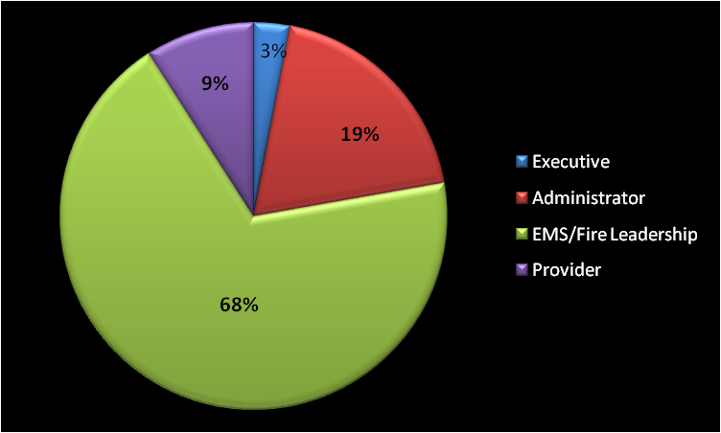
Survey Respondents
*For 911-responding agencies only

Slide 22
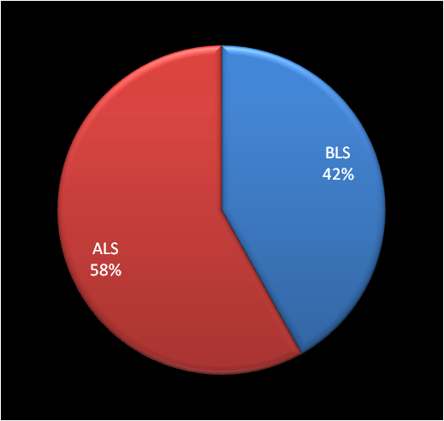
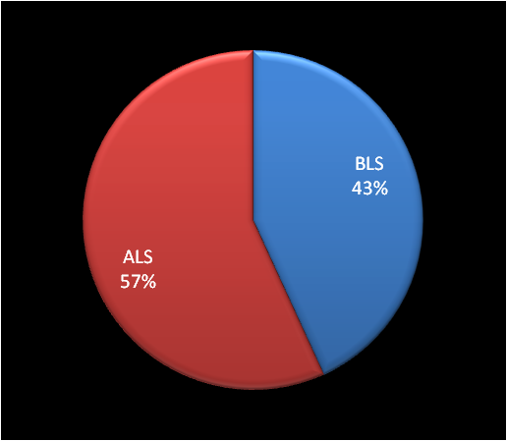
Highest Level of Certification of the EMS Agencies
NON-RURAL (63%)
RURAL (37%)
*For 911-responding agencies only

Slide 23
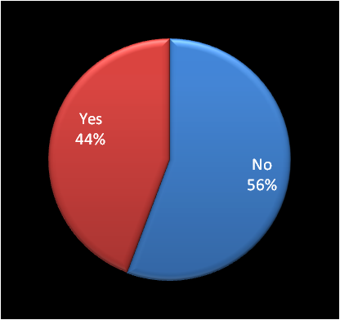
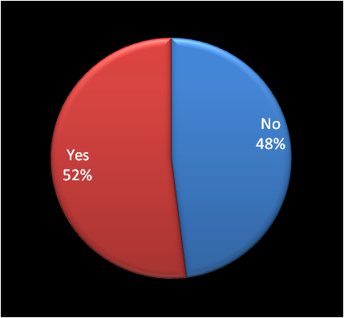
Transport from Scene to Hospital?*
NON-RURAL (63%)
RURAL (37%)
Only those who answered “yes” were asked about their equipment
*Includes first responders; 911-responding agencies only

Slide 24
EMS Agency Survey: Medical Direction
Online

Slide 25
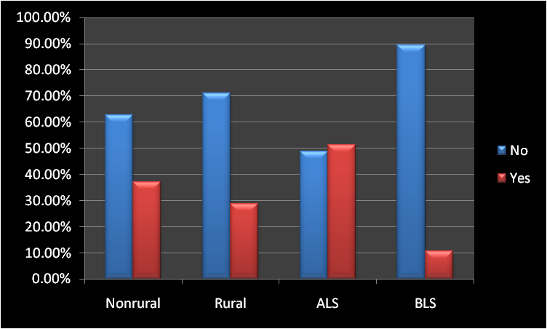
Attempt Contact with Online Medical Direction in Past Year for Pediatric Patient?*
*Pediatric = 0-18 years; for 911-responding agencies
Notes:
Attempts were more often made in nonrural areas
ALS is more likely to attempt contact with online medical control

Slide 26
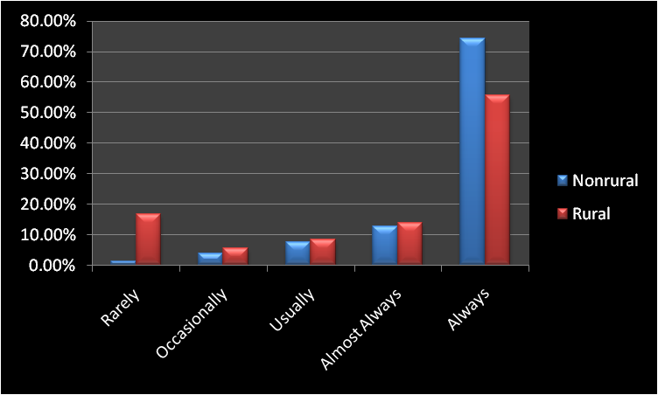
How Often was Online Medical Direction Available for Pediatric Patients?*
*For agencies that attempted contact w/in past year
Notes:
This only captures availability for those who tried to call. Since BLS and rural providers are less likely to call, it is difficult to be certain what the true availability is for the BLS provider and those in the rural setting.
Although this graph makes it seem that online direction is always available, this is true for only 68% of the time. Another way to state this is that universally available online medical direction is absent 32% of the time.

Slide 27
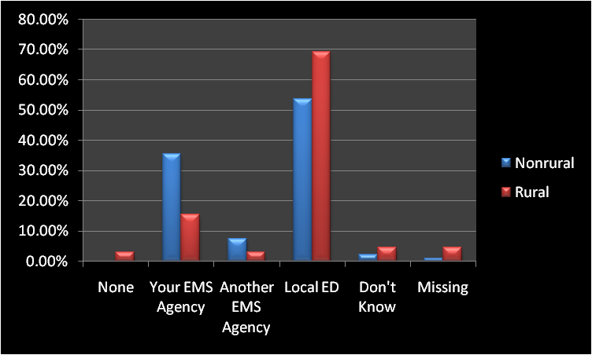
Primary Source of Online Medical Direction*
*For transporting agencies only
Notes:
It is often a local ED, especially in rural areas. EMS agencies in nonrural areas are more likely to have online medical direction from their own agency relative to rural agencies.

Slide 28
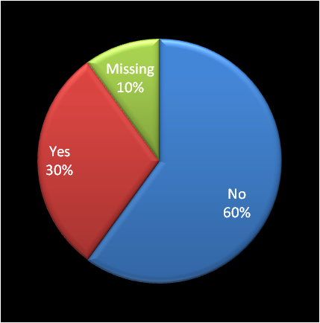
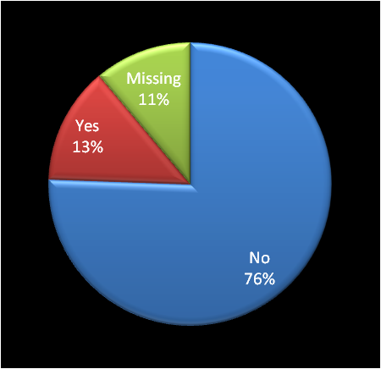
For Online Medical Direction, Is the Source a Children’s Hospital?*
NON-RURAL
RURAL
*For agencies who contact a local ED for online medical direction
Notes:
As expected, children’s hospitals are more accessible for online medical direction in nonrural areas

Slide 29
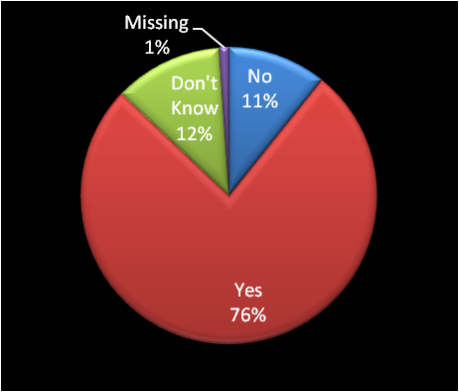
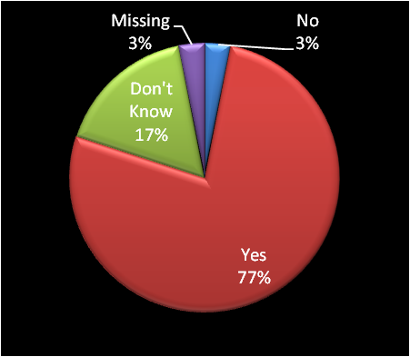
Desire for Online Medical Direction Through Base Station at Regional Children’s Hospital?*
NON-RURAL
RURAL
*For transporting agencies only
Notes:
Regardless of the location, online medical direction through a base station at a regional children’s hospital is desirable for ¾ of agencies

Slide 30
EMS Agency Survey: Medical Direction
Offline

Slide 31
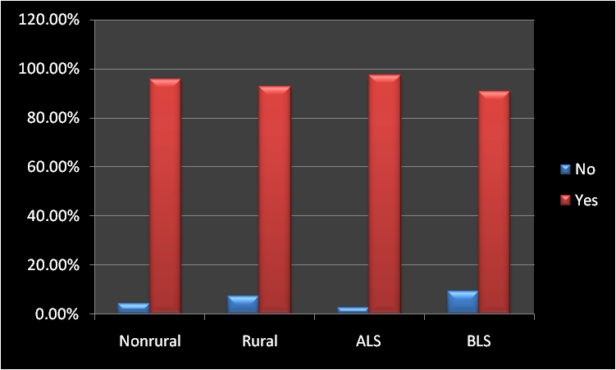
Written Protocols Available?*
*Paper/electronic; for 911-responding agencies
Notes:
It is reassuring to see that written protocols are available 95% of the time, regardless of setting or provider level.

Slide 32
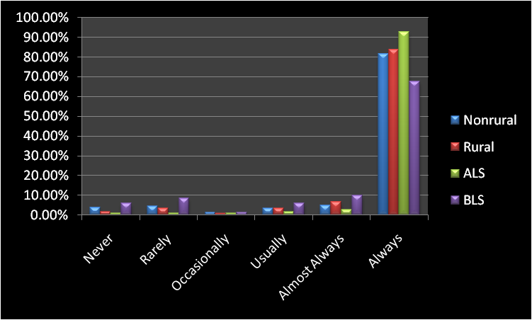
How Often Were Protocols Physically Available on Vehicle?*
*Paper/electronic protocols available; for 911-responding agencies only
Notes:
Protocols were physically available 78% of the time, regardless of setting. Though, for BLS providers, universal availability was true for only 61% of those surveyed. Some providers argue that the protocol should be memorized, and they won’t be looking something up in a critical situation. Availability of the protocols, however, may help prevent medication dosing errors. Even if the provider knows the treatment algorithm from memory, he/she may not recall drug doses.

Slide 33
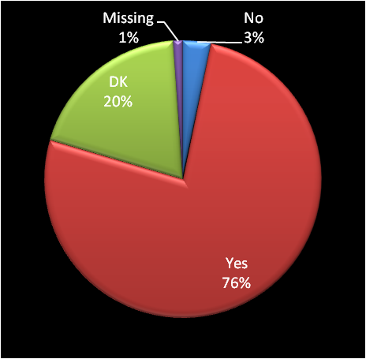
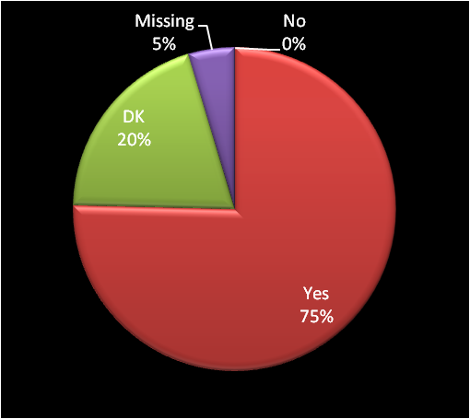
Would Your Agency Use EMSC-Created Evidence-Based Pediatric Protocols?*
NON-RURAL
RURAL
*For transporting agencies only
Notes:
Regardless of the location, ¾ of agencies would use evidence-based protocols created by EMSC

Slide 34
EMS Agency Survey: Equipment

Slide 35
Outliers
BLS vehicles per agency
Range = 1-57
Mode = 1
Median = 6
Average = 3.5
ALS vehicles per agency
Range = 1-116
Mode = 2
Median = 8
Average = 5.1
Data is reported both with and without the outlier BLS agency with 57 vehicles, when excluding it made a difference
Data is reported both with and without the outlier ALS agency with 116 vehicles, when excluding it made a difference

Slide 36
EMS Agency Survey: Equipment
Basic Airway
Notes:
Suction catheters
Nasal cannula
Non-rebreather mask
Self-expanding bag-valve
Mask for bag-valve
Nasal airway
Oral airway
Pulse oximeter
Bulb suction

Slide 37
Suction Catheters
Notes:
Rural BLS agencies were more likely to be missing the smaller sizes

Slide 38
Bulb Suction
Notes:
Bulb suction was widely available

Slide 39
Nasal Cannula
Notes:
Pediatric nasal cannulas are not routinely available, especially in rural BLS settings

Slide 40
Non-Rebreather Mask
Notes:
Nonrebreather masks are generally available; here’s an example when removing the outlier had a significant change in how the data could be interpreted

Slide 41
Self-Expanding Bag Valve
Notes:
Self-expanding bag-valves were often available

Slide 42
Mask for Bag-Valve
Notes:
Yet in rural settings, neonatal masks that attached to the bag-valve are missing frequently (27% of the time)

Slide 43
Nasal Airway
Notes:
Without the outlier and regardless of setting or provider level, nasal airways were absent in 10-20% of vehicles

Slide 44
Oral Airway
Notes:
Oral airways are routinely available

Slide 45
Pulse Oximeter
Notes:
Pediatric pulse oximetry probes are absent in many vehicles, especially in the rural setting (almost 20% of the time). This could be problematic now that the AHA recommends titrating oxygen to 94-100% in the setting of cardiac arrest (post-resuscitation) and neonatal resuscitation

Slide 46
EMS Agency Survey: Equipment
Advanced Airway
Notes:
Miller laryngoscope blades
Curved laryngoscope blades
Stylette
Magill forceps
End-tidal CO2 detector
Endotracheal tubes

Slide 47
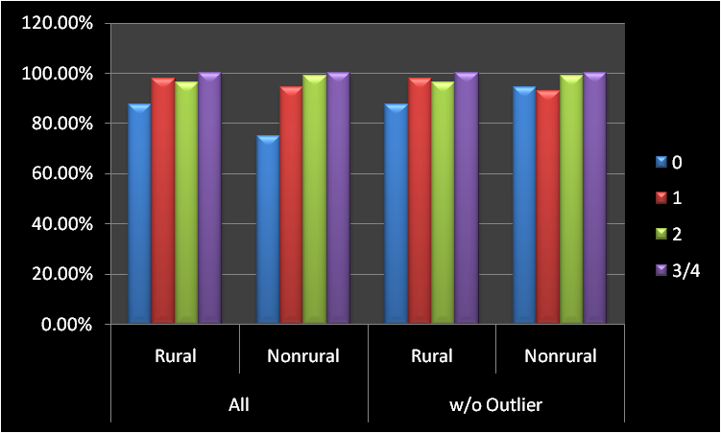
Miller Laryngoscope Blades*
*ALS Vehicles Only
Notes:
Generally laryngosopes were widely available; but a size 0 for neonates was absent 5-15% of the time.

Slide 48
Curved Laryngoscope Blades*
*ALS Vehicles Only
Notes:
Curved blades were widely available

Slide 49
Magill Forceps*
*ALS Vehicles Only
Notes:
Magill forceps were present in most cases, but 13% of the time, the pediatric size was absent

Slide 50
End-tidal CO2 Detector*
*ALS Vehicles Only
Notes:
This is concerning, since some form of end tidal CO2 detection is necessary to ensure adequate ventilations after more advanced airway management. This is especially deficient in rural settings.

Slide 51
Un/Cuffed Endotracheal Tubes*
*ALS Vehicles Only
Notes:
Even after removing the outlier, the smallest sizes of endotracheal tubes were missing 10-20% of the time in rural settings

Slide 52
EMS Agency Survey: Equipment
Cardiovascular
Notes:
Blood pressure cuff
AED
Defibrillator and pads
Cardiac pacing pads/cables

Slide 53
Blood Pressure Cuff
Notes:
Universally available

Slide 54
Automated External Defibrillator
Notes:
The absence of an AED on rural BLS units 20% of the time is very concerning

Slide 55
Defibrillator with Pads*
*ALS Vehicles Only
Notes:
Defibrillators and pads are universally available.

Slide 56
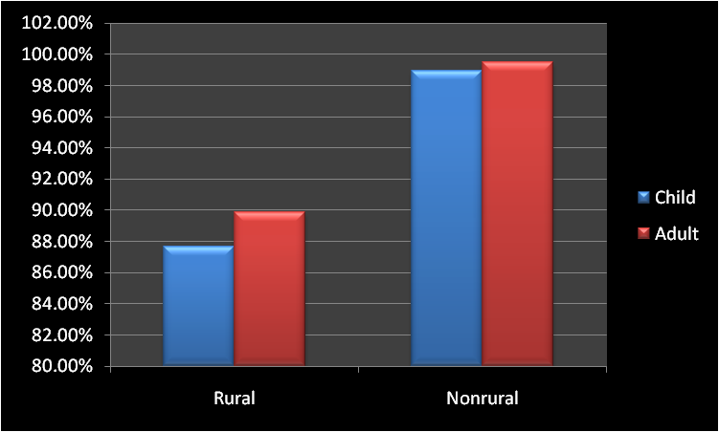
Cardiac Pacing Pads/Cables*
*ALS Vehicles Only
Notes:
Pacing for heart block may be a rare situation in the prehospital setting.

Slide 57
EMS Agency Survey: Equipment
Trauma / Environmental
Notes:
Thermal blanket and head cover
Rigid cervical collar
Lower extremity traction device
Extremity immobilization device

Slide 58
Thermal Blanket and Head Cover
Notes:
Widely available

Slide 59
Rigid Cervical Collar
Notes:
Small and medium cervical collars are at times absent

Slide 60
Lower Extremity Traction Device
Notes:
Pediatric-seized traction devices can sometimes be absent

Slide 61
Extremity Immobilization Device
Notes:
In addition, splints are often missing.

Slide 62
EMS Agency Survey: Equipment
Obstetrics / Neonatal
Notes:
Obstetrical Kit
Meconium Aspirator Adaptor

Slide 63
Obstetrical Kit
Notes:
Having the OB kit is not an issue

Slide 64
Meconium Aspirator Adaptor*
*ALS Vehicles Only
Notes:
The meconium aspirator adaptor is missing in 20-40% of vehicles, though the new newborn resuscitation guidelines now do not recommend routine meconium suctioning.

Slide 65
EMS Agency Survey: Equipment
Other
Notes:
Length Based Tape
Intravenous catheter
Intraosseous needles
Syringes
All Equipment

Slide 66
Length Based Tape
Notes:
Length based tapes are missing in the rural BLS setting, though one would argue that the tape focuses on drug doses and advanced airways sizes, both of which are outside the scope of practice of a BLS participant.

Slide 67
Intravenous Catheter*
*ALS Vehicles Only
Notes:
No problem here

Slide 68
Intraosseous Catheter*
*ALS Vehicles Only
Notes:
In the rural setting, these can be missing in 10% of cases.

Slide 69
Syringes*
*ALS Vehicles Only
Notes:
These are widely available

Slide 70
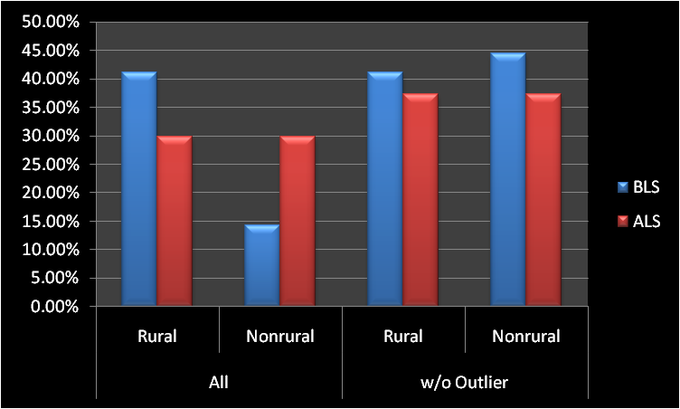
All Equipment
Notes:
Having all of the equipment is rare

Slide 71
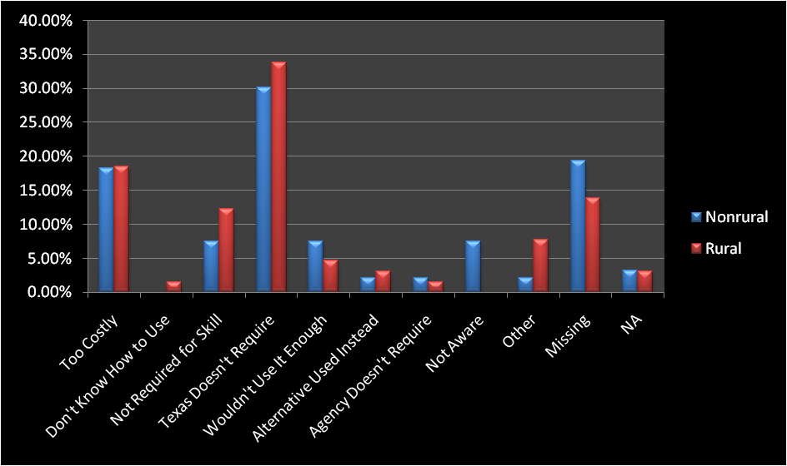
Most Common Reason For Not Carrying Recommended Equipment*
*For transporting agencies only
Notes:
Note that the main reason (32%) was that the state does not require it
Also note that although 18% were concerned about cost, there was no difference between rural and nonrural
“Other” comments are summarized on the next slide

Slide 72
“Other” Reasons for Not Carrying Equipment
All of the above
We carry the majority
Equipment not readily available for purchase
Not sure
Slipped past our equipment list
We would like to carry all as appropriate

Slide 73
Hospital Survey
Inter-facility Transfer Guidelines and Agreements
Notes:
Length Based Tape
Intravenous catheter
Intraosseous needles
Syringes
All Equipment

Slide 74
Results: Hospital Survey
382
All Hospitals
Not Contacted
187
195
Sample of Hospitals
No Response
50% Sampled
81
165
Completed Survey
85% Responded
Inter-facility transfer guidelines and agreements
43% of Texas Hospitals

Slide 75
Guidelines / Agreements
Component Present | % Present
GUIDELINES | 83%
Process for initiation | 78%
Process for selecting facility | 59%
Process for selecting transport service | 64%
Process for transfer, including consent | 83%
Plan for transfer of the medical record | 78%
Plans for transfer of copy of signed transport consent | 78%
Plan for transfer of personal belongings of the patient | 58%
Plan for provision of directions and referral institution information to family | 52%
AGREEMENTS | 67%

Slide 76
SUMMARY: Medical Direction
Online
Absent 32% of the time
Source is often local ED in rural areas
Children’s hospital-based for <30%, but highly desired
Offline
Written protocols often available (95%)
75% would use EMSC-created evidence-based protocols

Slide 77
SUMMARY: Basic Airway Equipment
Rural BLS agencies likely to be missing
Suction catheters in smaller sizes
Pediatric nasal cannulae
Neonatal masks that attach to the bag-valve
Nasal airways were absent in 10-20% of vehicles (all settings/providers)
Pediatric pulse oximetry probes are absent, especially in the rural setting

Slide 78
SUMMARY: Advanced Airway Equipment
Miller 0 laryngoscopes absent 5-15% of the time
Pediatric Magill forceps absent 13% of the time
End-tidal CO2 detection absent in 15%
Smallest endotracheal tubes (<6.0 mm) absent 10-20% of the time in rural settings

Slide 79
SUMMARY: Equipment and Supplies
Cardiovascular
Absence of an AED on rural BLS units 20% of the time
Trauma/environmental
Small and medium cervical collars are at times absent
Lower extremity traction devices sometimes be absent

Slide 80
SUMMARY: Equipment and Supplies
Obstetrics/neonatal
30% missing meconium aspirator adaptors
Other
30 of BLS units missing length-based tape
Only 35-45% of vehicles had all equipment items
Lack of a State mandate is the most common reason why equipment is absent

